Slide 1
Drone Conversion Appliances (DCA)
Date: 10 February 2023
DCA Team
Project Advisor: Dr. Yongcan Cao, ECE
Team Sponsor: USL Lab, UTSA
Team Members: Ehab Afsoonko, Conrad Obeng, Lexi McMinn, Mark James Jr., Matthew Moubray
“Expanding the world of Modifiable Drone Transit.”

Slide 2
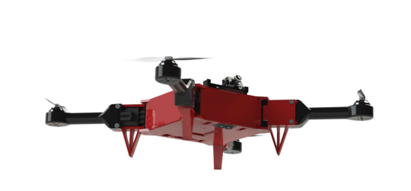
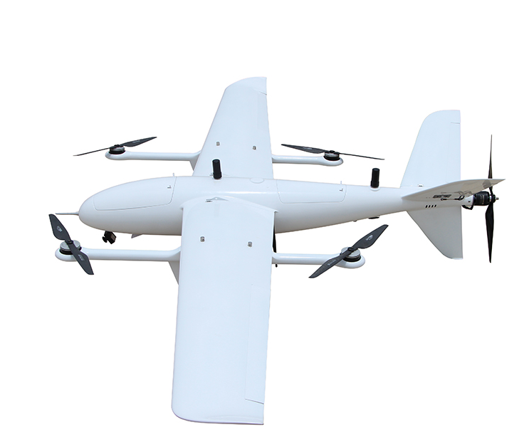
Background/Overview Slide
Every UAV, drone, or RC plane on the market is a single modality kit and constrained to a single flight pattern. Our project aims to expand the number of vehicle transportation modalities for the ModiFly Quadcopter through the addition of a VTOL Fixed-Wing module. This will allow for user to take the mainframe from the Modifly Quadcopter and attach the VTOL Fixed-Wing module without the need to purchase and build a whole entire kit. The VTOL-Fixed WIng module features are:
Longer flight duration
Reduced battery consumption
Vertical-Takeoff and Landing capability
Higher forward propulsion
Increase payload

Slide 3
Tasks Completed Slide
Finalized the following parts:
Forward Propeller and Forward Propeller ESC
Final Servo Count
4in1 ESC
Finalized Frame Design
Setup new meeting cadence

Slide 4
Current Problem or Obstacles Slide
Creating an aerodynamically stable design
ModiFly Extended base
Weight distribution and overall calculation
Component Placement
H-Frame vs X-Frame
3D Printing Resizing
Airframe Selection
How to connect VTOL Booms?
How to connect our ModiFly Base to VTOL Fixed Wing Module

Slide 5
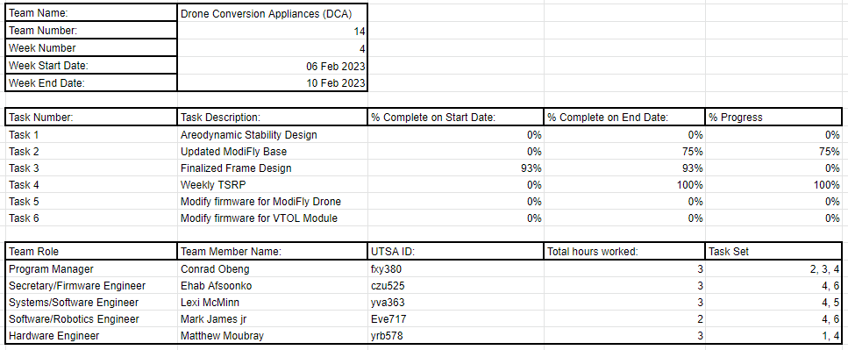
Week 3 Team Project Contribution Report

Slide 6
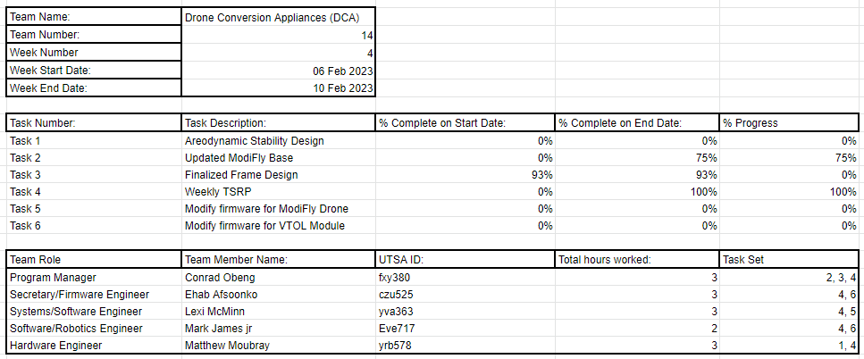
Week 4 Team Project Contribution Report

Slide 7
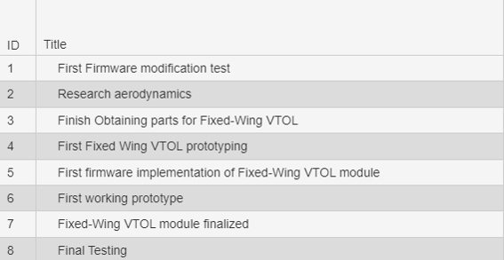
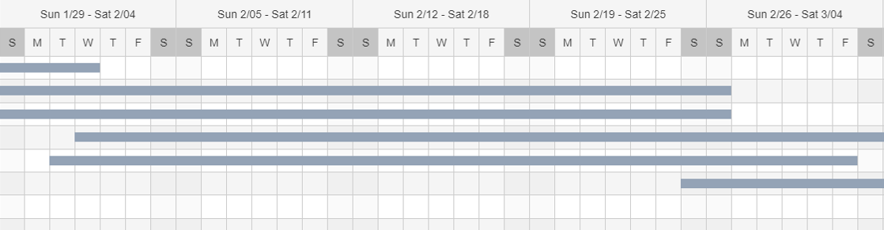
Work Breakdown Structure

Slide 8
Ongoing and Upcoming Tasks
Put in order for frame and servos
Modify ArduPlane firmware for our specific frame
Modify frame with extra propellers for VTOL capabilities
Begin prototyping modified firmware for VTOL

Slide 9
Budget Slide
Item | Description | Cost
PixHawk 2.4.8 | Flight Controller | ~$160
iFlight Xing-E Pro 2207(4pcs) | VTOL Motor | ~$66
HAKRC 45A 2-6S BLHeli_S 4in1 ESC | Motor ESC | ~$49.99
Turnigy Aerodrive SK3 | Forward Propeller Motor | ~$43.99
ZTW Mantis 85A ESC | Forward Propeller ESC | ~47.90

Slide 10





Biographies Slide
Ehab Afsnooko - Firmware Engineer - C++, Python, Verilog, embedded systems
Conrad Obeng - Engineering Manager - Python,Drone Engineering,Drone Firmware
Lexi McMinn - Systems/Software Engineer - C++,Python,Verilog,VHDL
Mark James Jr. - Software/Robotics Engineer- Python,C++,Java
Matthew Moubray - Hardware Engineer - C++, Python, LabView, eCalc, Solidworks

Slide 11
Questions?

